Slide 1

Chapter 4 Continuous-Wave Modulation
Linear modulation: 线性调制
Amplitude modulation (AM) 调幅
Double-sideband modulation (DSB) 双边带调制
Single-sideband modulation (SSB) 单边带调制
Non-linear modulation: 非线性调制
● Frequency Modulation 调频
● Phase Modulation 调相
明德格物，立己达人

Slide 2
sm(t)
m(t)
BPF
LPF
~
×
H(ω)
Channel
×
m(t)
cosωct
cosωct
n(t)
Linear modulation model (filter method)
Improve G
引入微积分
sm(t)
m(t)
~
∫
Modulator
Channel
demodulator
m(t)
Sacrifice B
牺牲带宽
Improve G
n(t)
Non-Linear modulation model (FM)

Slide 3
FM communication system
Definitions:
System model:
Time & frequency-domain characteristics
Anti-noise performance 抗噪声性能
Practical FM modulation 实际 FM 系统
Special topic: NBFM (窄带调频)

Slide 4
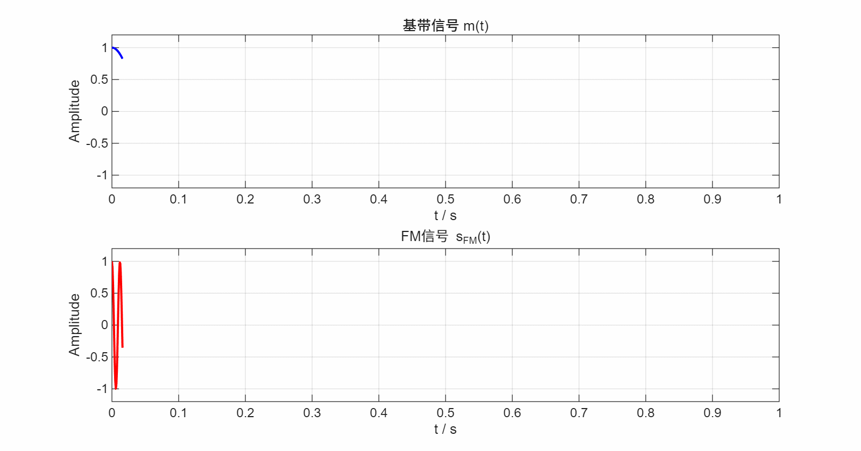
sm(t)
m(t)
~
∫
Modulator
Channel
demodulator
m(t)
Sacrifice B
Improve G
n(t)
Angle modulation
● Angle(相位/频率) of the carrier wave is varied with the m(t)
● Provides a practical means of exchanging channel bandwidth B
for improved anti-noise performance G.
● Envelope of a PM or FM signal is constant.
The envelope is constant,
while f varies linearly with m(t).

Slide 5

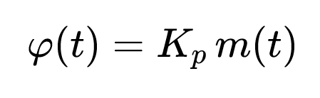
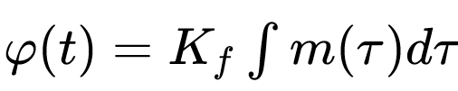
sFM(t)
m(t)
~
∫
Modulator
Channel
demodulator
m(t)
n(t)
Non-Linear modulation model (FM)
FM and PM can be interconverted. FM 和PM可以互换

Slide 6
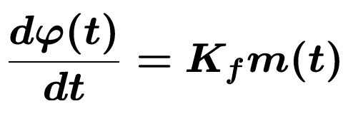
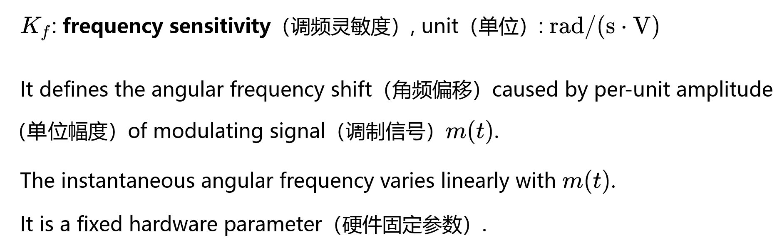
sFM(t)
m(t)
~
∫
Modulator
Channel
demodulator
m(t)
n(t)
Non-Linear modulation model (FM)
Angle modulation——FM
时域定义，反映瞬时频率跟随调制信号变化的灵敏程度
越大越灵敏

Slide 7
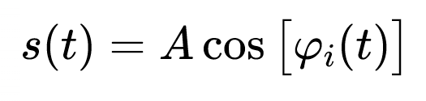
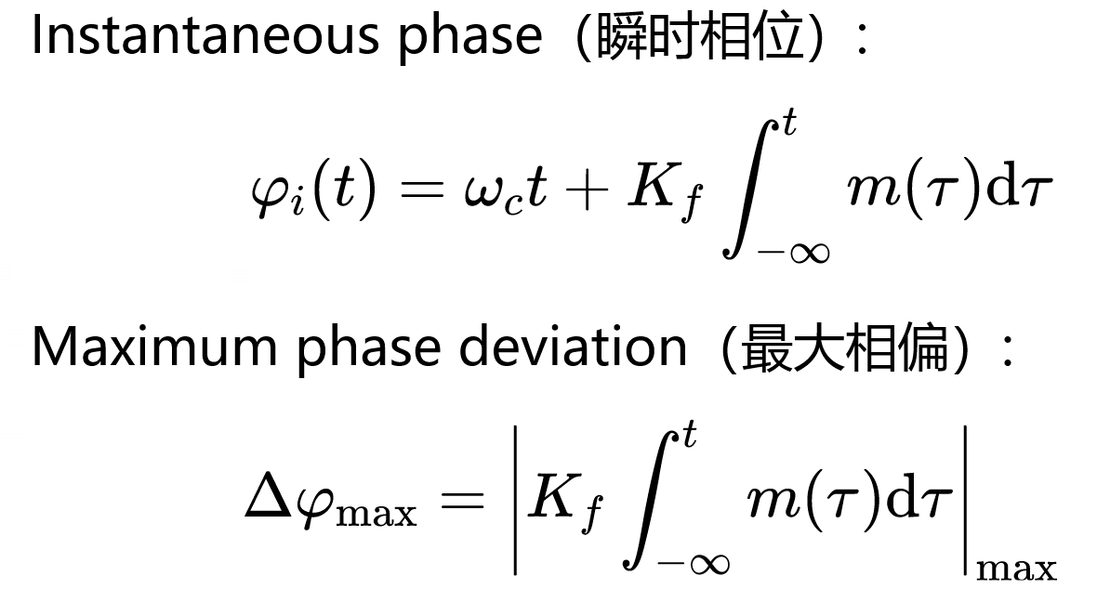
FM mathematical definition
时域定义
It represents the maximum deviation of instantaneous phase from the carrier phase.
（它代表瞬时相位相对于载波相位的最大偏移量）

Slide 8
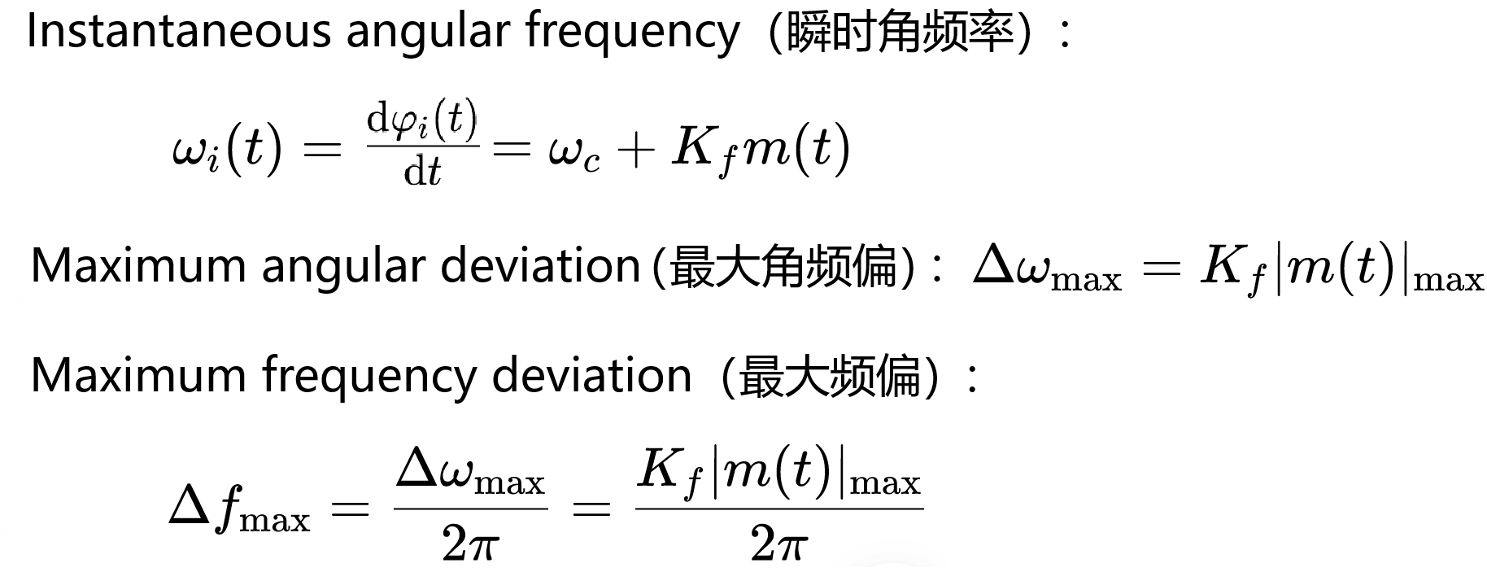
FM mathematical definition
时域定义
It represents the maximum deviation of instantaneous frequency from the carrier frequency.
（它代表瞬时频率相对于载波频率的最大偏移量）

Slide 9
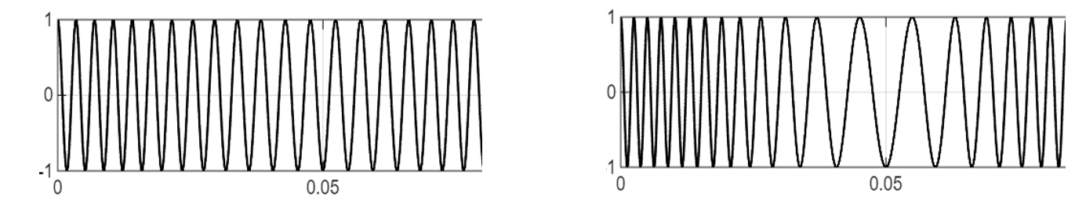
时域定义
Reflect variation of frequency spacing｜反映频率疏密变化

Slide 10
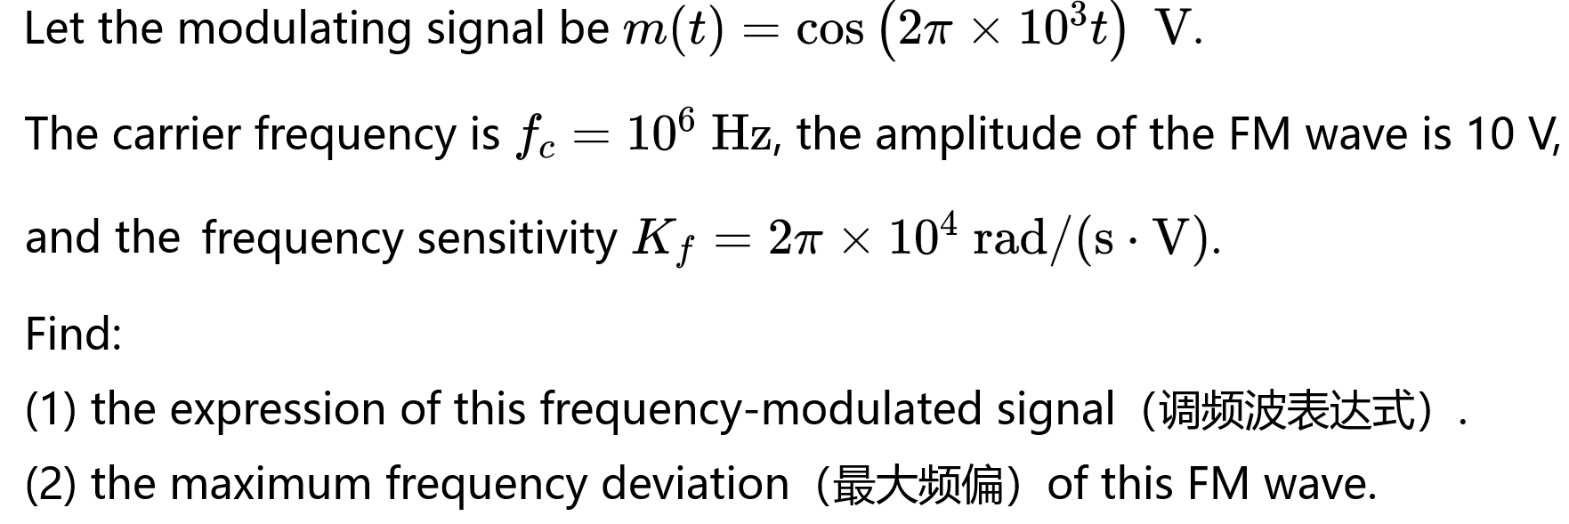
Example

Slide 11
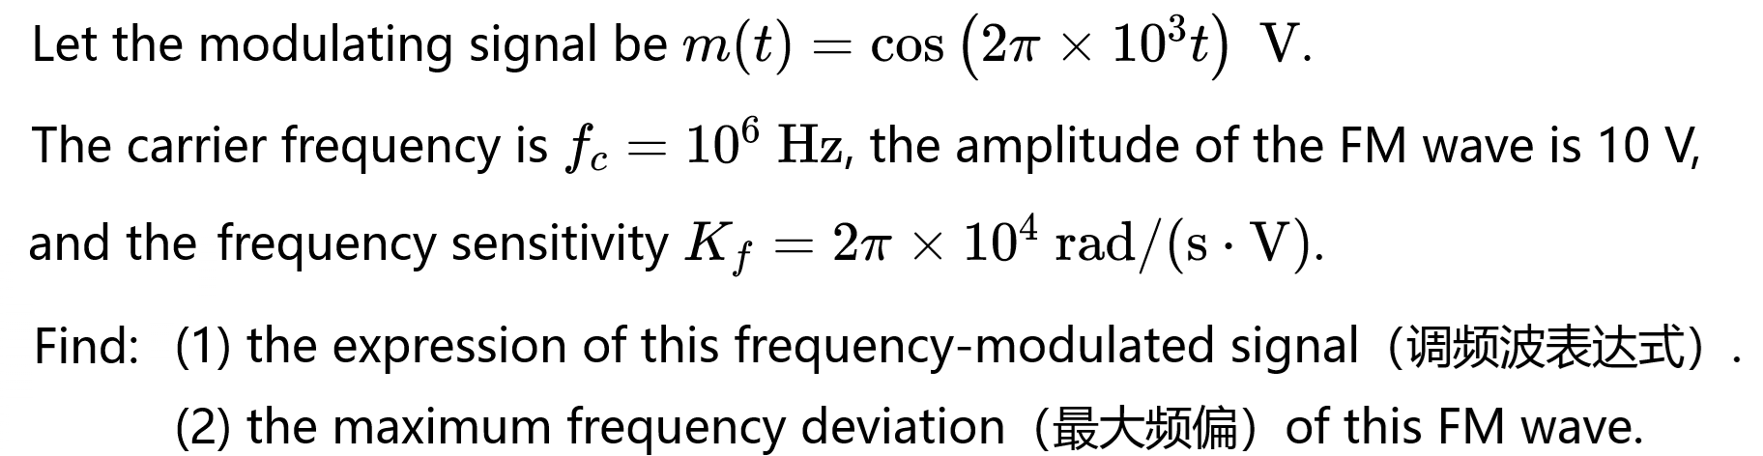
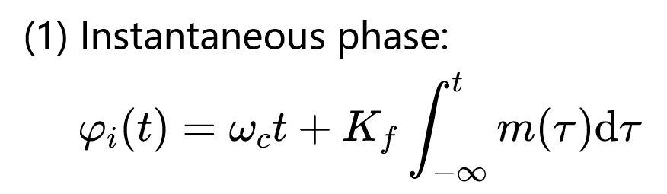
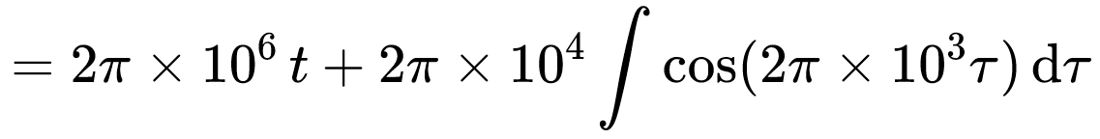
Example

Slide 12
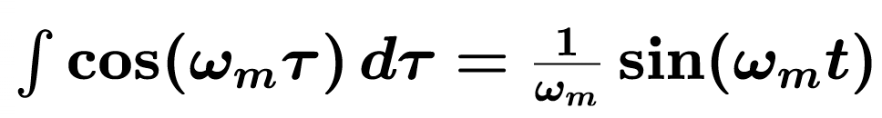
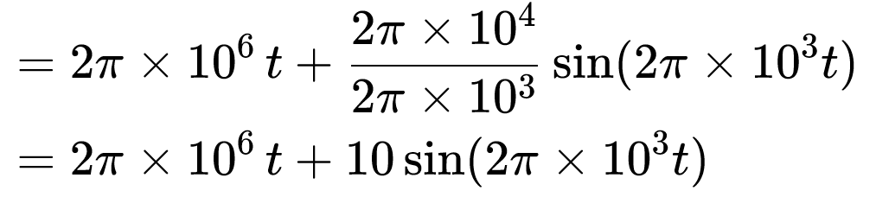
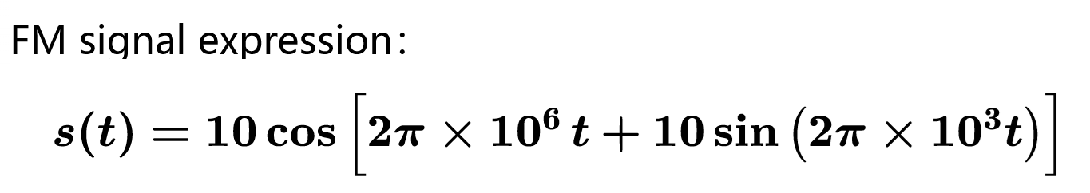
Example

Slide 13


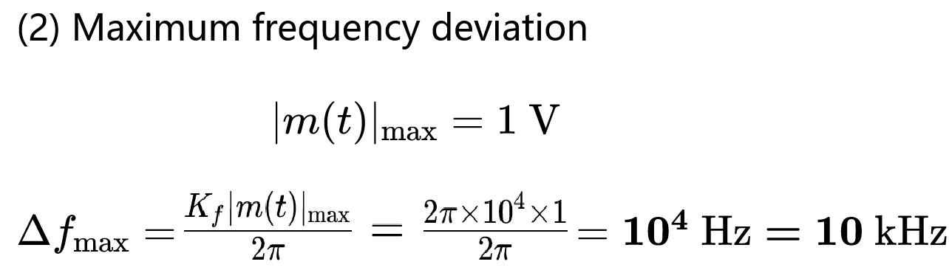
Example
The maximum frequency deviation cannot determine the signal bandwidth.

Slide 14

Example
The maximum frequency deviation cannot determine the signal bandwidth.
Reflect variation of frequency spacing｜反映频率疏密变化

Slide 15
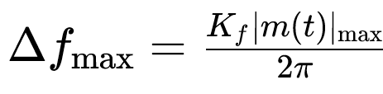
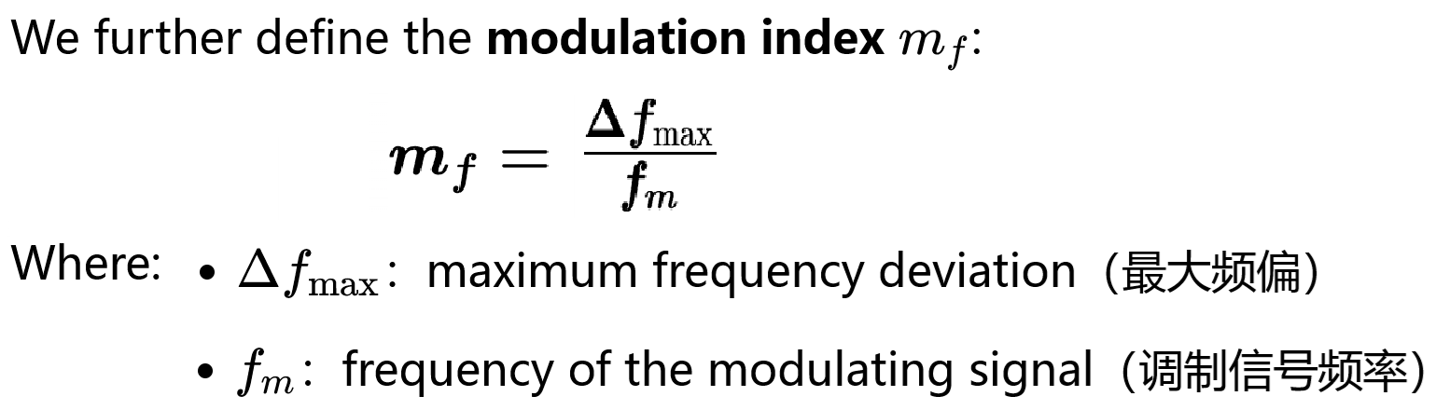
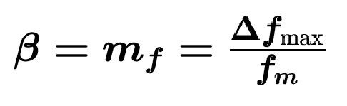
β or mf —— determine the signal bandwidth
Maximum frequency deviation：
调制指数
for PF &FM
Assume single-tone modulation 假设为单音信号.

Slide 16
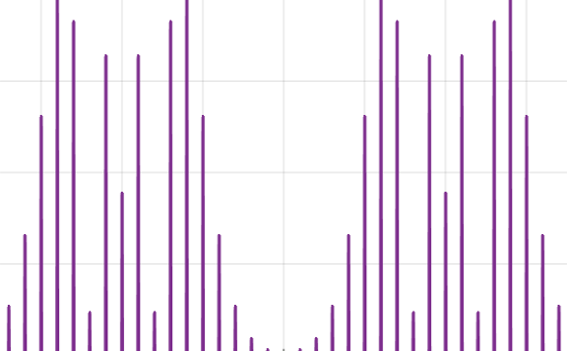
β or mf —— determine the signal bandwidth
Maximum frequency deviation：
调频指数
for FM
这个指标决定调频信号的边带分布结构及带宽。

Slide 17
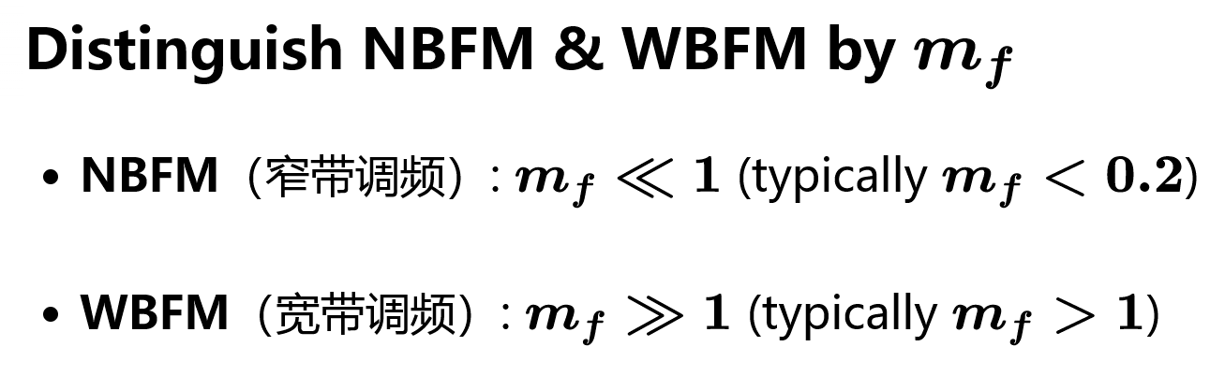
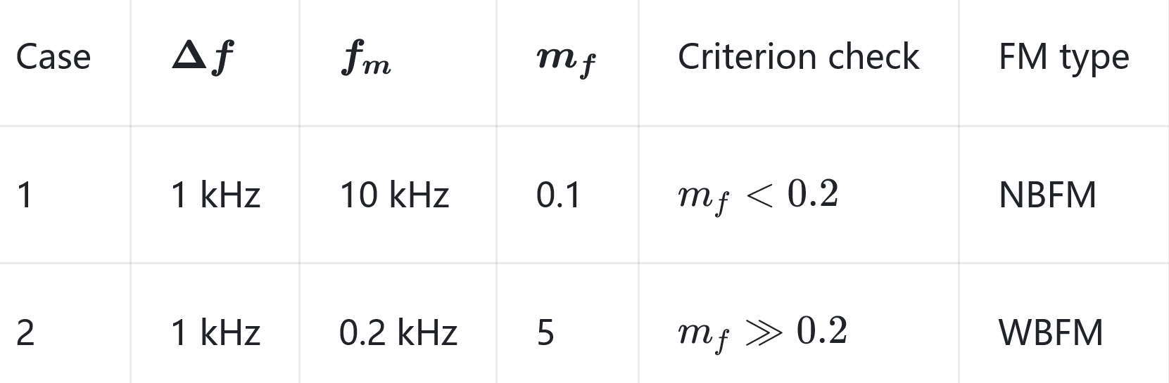
FM mathematical definition——β or mf

Slide 18
FM mathematical definition——β or mf
We mainly discuss WBFM signals because they have better anti-noise performance.

Slide 19
FM system model
Definitions:
System model:mainly discuss WBFM
--direct直接 method (VCO)：常用
--indirect 间接method：不常用，早期
Time & frequency-domain characteristics
Anti-noise performance 抗噪声性能
Practical FM modulation 实际 FM 系统
Special topic: NBFM (窄带调频)

Slide 20
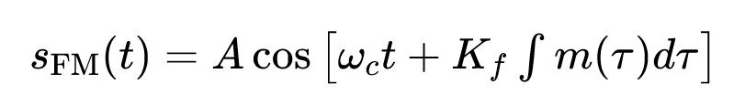
WBFM System model——①direct method
m(t)
VCO
sFM(t)
鉴频器+LPF
Channel
Discriminator+LPF
~
BPF &
Limiter
m(t)
cosωct
n(t)
VCO : Voltage‑Controlled Oscillator 压控振荡器
Varactor diodes
变容二极管
m(t)电压控制频率ωi
Improvement: Phase‑Locked‑Loop (PLL：锁相环) Modulator with Better Frequency Stability.

Slide 21
WBFM System model ——①direct method
sFM(t)
?
Discriminator
鉴频器
sFM(t)
m(t)
VCO
~
Channel
BPF &
Limiter
LPF
m(t)
n(t)

Slide 22
WBFM System model ——①direct method
sFM(t)
+ ？
sFM(t)
m(t)
VCO
~
Channel
BPF &
Limiter
LPF
m(t)
n(t)
Differentiator 微分器+？
FM &AM

Slide 23
WBFM System model——①direct method
sFM(t)
+ Envelope
detector
sFM(t)
m(t)
VCO
~
Channel
BPF &
Limiter
LPF
m(t)
n(t)
Differentiator 微分器+？
FM &AM
Envelope detector: extract envelope, remove DC,
and recover demodulated output via LPF.
Non coherent detector

Slide 24
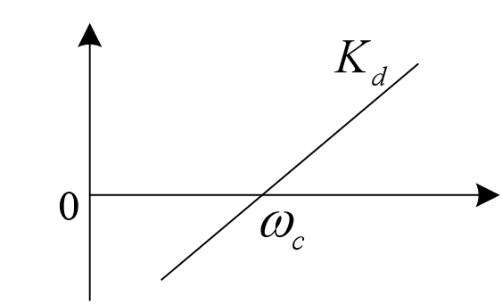
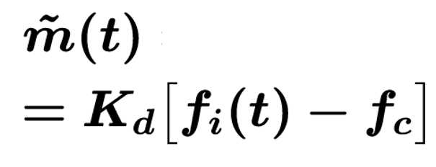
WBFM System model——①direct method
sFM(t)
+ Envelope
detector
sFM(t)
m(t)
VCO
~
Channel
BPF &
Limiter
LPF
m(t)
n(t)
Differentiator 微分器+？
Input frequency

Slide 25
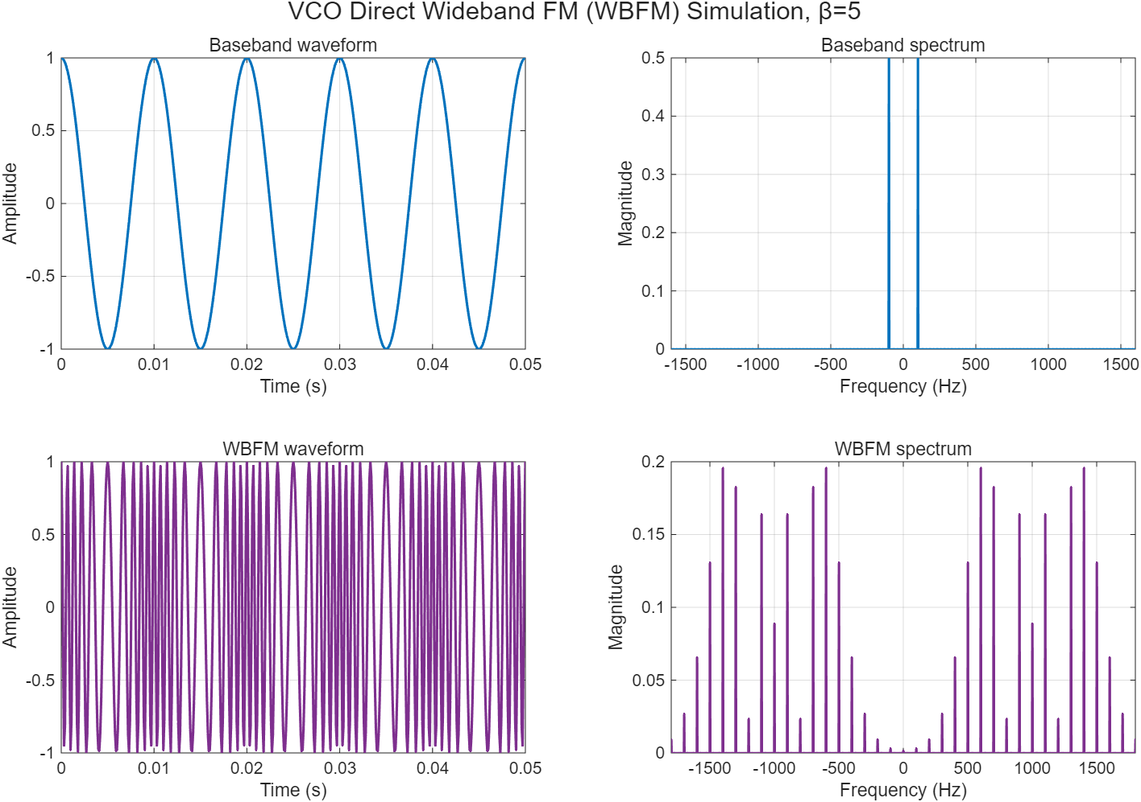
WBFM

Slide 26


WBFM System model—— ②Armstrong method
阿姆斯特朗方法
Indirect method
phase discriminator
相位鉴频器
sNBFM(t)
sWBFM(t)
m(t)
NBFM
Discriminator
鉴频器
~
Muliplier
倍频器
BPF+
limiter
m(t)
slope discriminator
或斜率鉴频器
The Armstrong method was common in the discrete-component era. It is rarely used in practical engineering today and serves only as teaching material.
阿姆斯特朗法：早年分立元件时代用得多；现在几乎不再工程落地，仅作为教学内容。

Slide 27
Frequency Modulation system
Definitions:
System model:mainly discuss WBFM
Time & frequency-domain characteristics
Anti-noise performance 抗噪声性能
Practical FM modulation 实际 FM 系统
Special topic: NBFM (窄带调频)

Slide 28
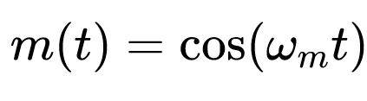
Table 1 Time & Frequency Domain Comparison
单音调制信号为例：
Signal | Time-domain 时域 | Frequency-domain 频域
SWBFM
Waveformor spectrum | (绘制WBFM时域波形) | （绘制 WBFM频谱）

Slide 29
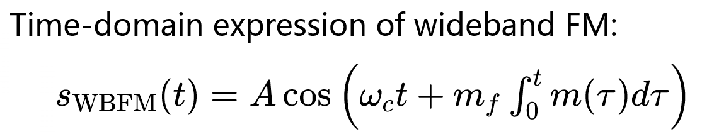
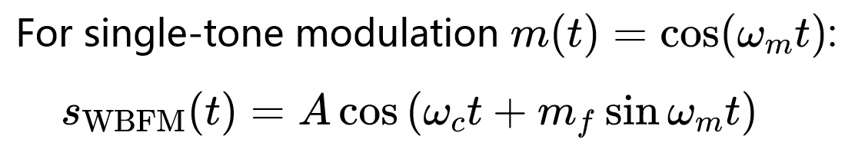
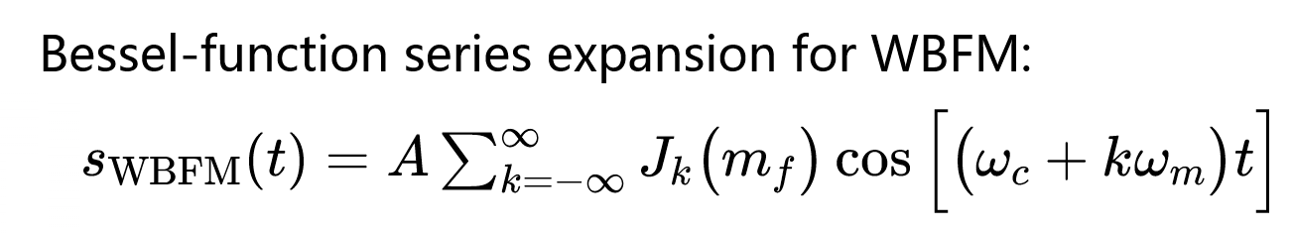
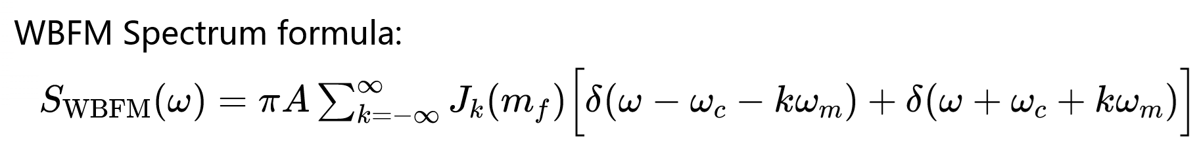
Time & Frequency Domain characteristics
PWBFM=Pc

Slide 30
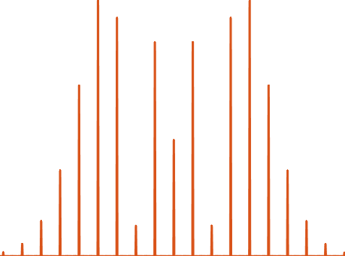
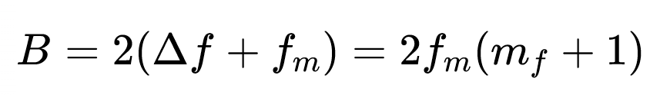
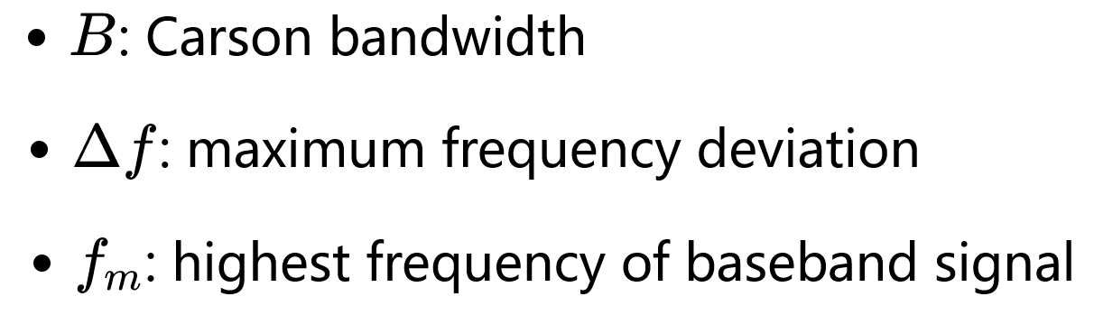
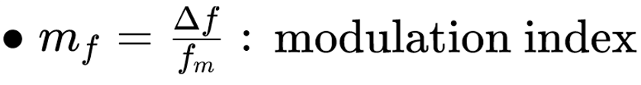
m(t)
sNBFM(t)
sWBFM(t)
NBFM
Muliplier
倍频器
mf,NB
mf,WB
Carson’s rule卡森公式
Spectrum

Slide 31
m(t)
sNBFM(t)
sWBFM(t)
NBFM
Muliplier
倍频器
mf,NB
mf,WB
Carson’s rule卡森公式
Spectrum
Since the theoretical bandwidth is unlimited, we only consider the main energy. This formula accounts for only the main sidebands.

Slide 32
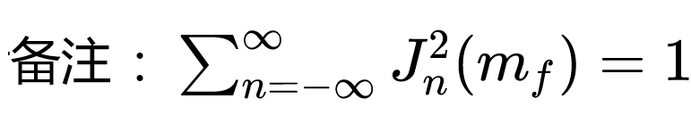
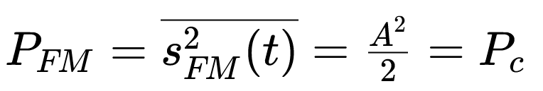
m(t)
sNBFM(t)
sWBFM(t)
NBFM
Muliplier
倍频器
mf,NB
mf,WB
Spectrum
PFM=Pc
调频信号的平均功率等于未调载波的平均功率。

Slide 33
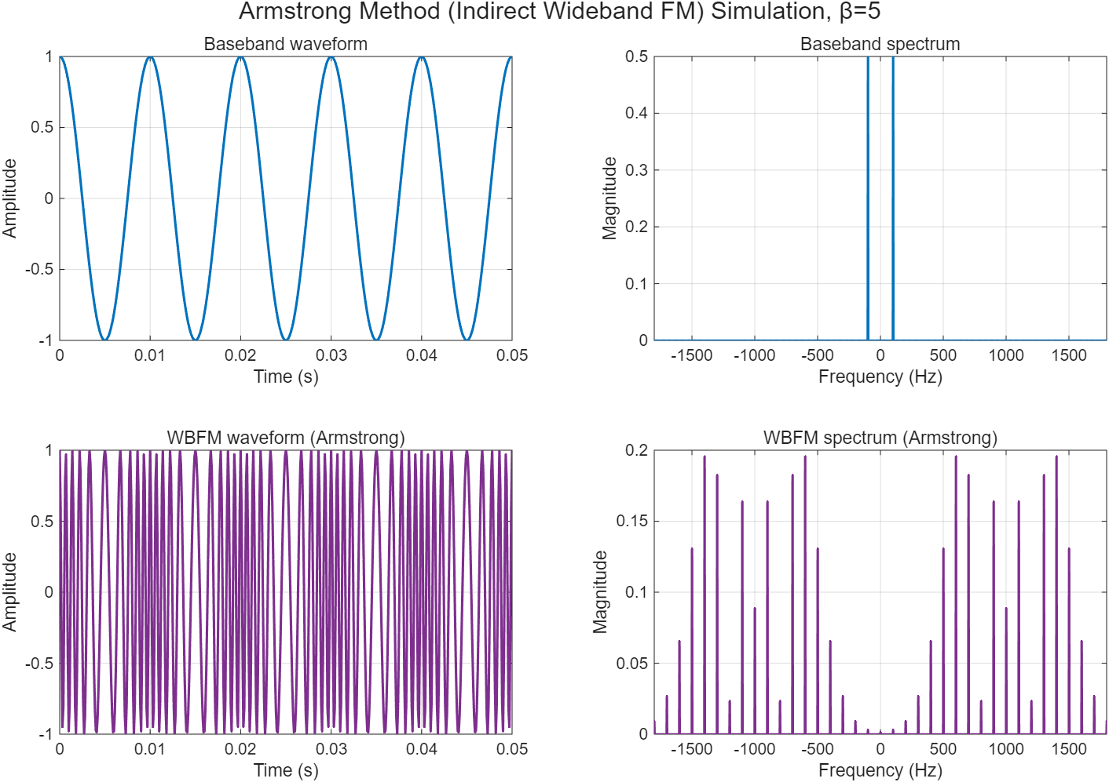

Slide 34
Frequency Modulation system
Mathematical definitions:
System model:
Time & frequency-domain characteristics
Anti-noise performance 抗噪声性能
--Large SNR
--Small SNR
Practical FM system 实际 FM系统
Special topic: NBFM (窄带调频)

Slide 35
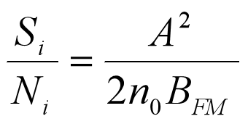

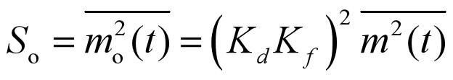
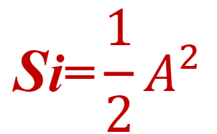
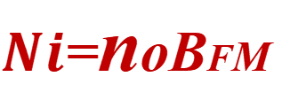
Anti-noise performance ——Large SNR
$$\text{S}\text{i}\text{=}\frac{1}{2}A^{2}$$
鉴频器+LPF
sFM(t)
Discriminator
+LPF
m(t)
VCO
~
Channel
BPF &
Limiter
m(t)
$Ni$=noBFM
n(t)

Slide 36
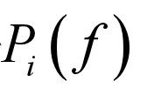
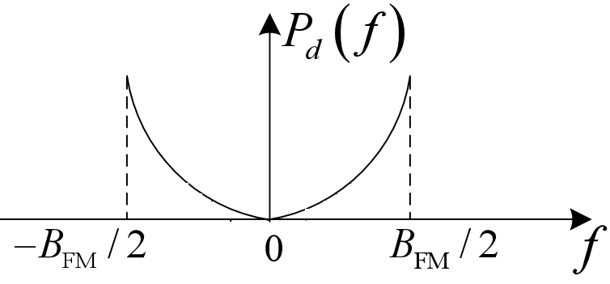
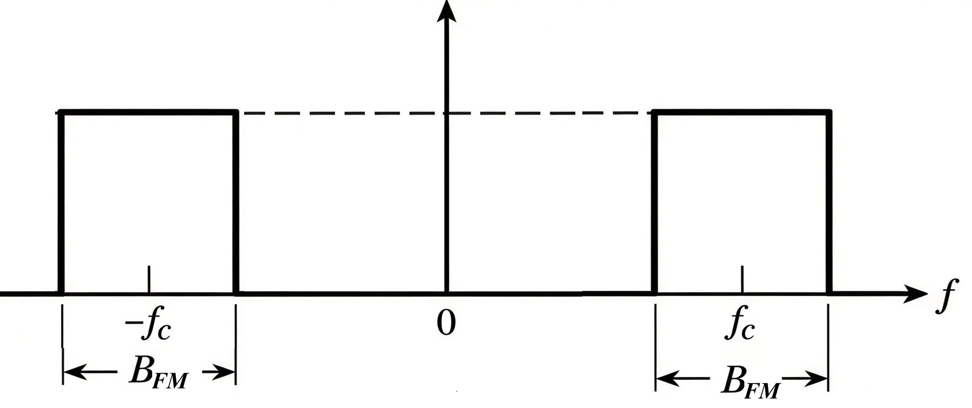
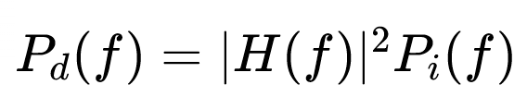
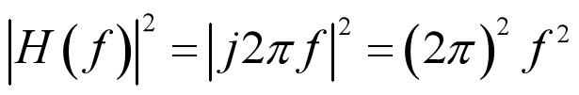

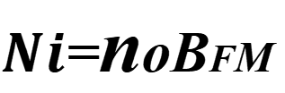
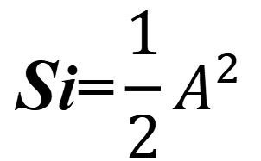
Anti-noise performance ——Large SNR
$$\text{S}\text{i}\text{=}\frac{1}{2}A^{2}$$
鉴频器+LPF
sFM(t)
Discriminator
+LPF
m(t)
VCO
~
Channel
BPF &
Limiter
m(t)
$Ni$=noBFM
$No$= $？$
n(t)
The differentiator is a linear time-invariant (LTI) filter.
Difficulty: Solve for $No$
Discriminator
H(f)

Slide 37

$$\text{S}\text{i}\text{=}\frac{1}{2}A^{2}$$
鉴频器+LPF
sFM(t)
Discriminator
+LPF
m(t)
VCO
~
Channel
BPF &
Limiter
m(t)
$Ni$=noBFM
n(t)
Difficulty: Solve for $No$
Discriminator
+LPF

Slide 38





鉴频器+LPF
$$\text{S}\text{i}\text{=}\frac{1}{2}A^{2}$$
Discriminator
+LPF
~
m(t)
$Ni$=noBFM
Singe-tone modulation

Slide 39
Anti-noise performance ——Large SNR
When m_{f} >> 1
In FM broadcasting, mf=5 is commonly adopted,
GFM=?
A higher modulation index greatly improves the anti-noise performance of FM systems.

Slide 40
Anti-noise performance FM VS AM
Single-tone modulation
When m_{f} >> 1
Sacrificing B to improve SNR

Slide 41


Example 4 —— GFM

Slide 42

Anti-noise performance ——Small SNR
Threshold effect

Slide 43
FM communication system
Definitions:
System model:
Anti-noise performance 抗噪声性能
Time & frequency-domain characteristics
Practical FM modulation 实际 FM 系统
Special topic: NBFM (窄带调频)

Slide 44
Practical FM communication system
Transmitter (TX)
m(t)
Pre-emphasis
预加重
FM Modulator
RF Power Amp
s(t)
Hₚ(f)
VCO, k_f
constant envelope
n(t)
Channel
AWGN, interference and multipath fading
m̃(t)
r(t)
De-emphasis
去加重
BPF
Limiter
Discriminator
LPF
band-pass
amplitude
FM demodulator
post-detection
H_d(f) = 1 / Hₚ(f)
Receiver (RX)
FM System Model
●Pre-emphasis & de-emphasis: Improve output SNR.
预加重 & 去加重：提升输出信噪比。
● Limiter: Eliminate amplitude noise.
限幅器：消除幅度噪声

Slide 45

FM communication system——video
Compared with AM broadcasting, FM stereo broadcasting has a higher frequency band and wider bandwidth. It supports stereo transmission with better sound quality and anti-interference performance.
与 AM 广播相比，调频立体声广播频段更高、带宽更大，可传输立体声，音质好、抗干扰强。

Slide 46

Discussion & Summary——WBFM system

Slide 47
FM communication system
Definitions:
System model:
Time & frequency-domain characteristics
Anti-noise performance 抗噪声性能
Practical FM modulation 实际 FM 系统
Special topic: NBFM (窄带调频)
自学

Slide 48
WBFM System model—— Armstrong method
阿姆斯特朗方法
m(t)
phase discriminator
相位鉴频器
∫
×
➖
sNBFM(t)
sWBFM(t)
Discriminator
鉴频器
~
Asinωct
+
Muliplier
倍频器
BPF+
limiter
m(t)
Acosωct
➕
Phase-
shifter
slope discriminator
或斜率鉴频器
NBFM
Muliplier
倍频器
WBFM
Indirect method
阿姆斯特朗法：早年分立元件时代用得多；现在几乎不再工程落地，仅作为教学内容。

Slide 49



NBFM (窄带FM) System model
窄带的相位条件

Slide 50


NBFM (窄带FM) System model——Generation
m(t)
Integrator
积分器
➖
×
Asinωct
sNBFM(t)
+
Acosωct
➕
Phase-shifter
Block diagram of a method for generating a narrowband FM signal.

Slide 51

NBFM (窄带FM) System model——完整系统
m(t)
Coherent detector
∫
×
➖
sNBFM(t)
Asinωct
BPF+
limiter
LPF
~
~
+
×
m(t)
m(t)
Acosωct
Phase-shifter
➕
R
T
-Asinωct
-sinωct

Slide 52


NBFM (窄带) System model——时频域特性
NBFM
mf$=0.2$
Poor power efficiency
$$B_{\text{NBFM}}≈2f_{m}$$

Slide 53


NBFM (窄带) VS AM
AM
$$B_{AM}=2f_{m}$$
mf$=0.2$
Poor power efficiency
NBFM
$$B_{\text{NBFM}}≈2f_{m}$$

Slide 54


mf$=0.2$
Time domain: Nearly constant amplitude; information carried by phase.
Frequency domain: Carrier plus one pair of sidebands. Upper and lower sidebands have opposite signs.
Bandwidth: B=2fm, same as AM.
Drawback: Poor power efficiency. Most power lies in the useless carrier. Rarely used directly for transmission, used to generate WBFM.

Slide 55


Time & Frequency Domain characteristics
单音调制信号为例：
Weighting factor, mf<0.2, the sidebands decay rapidly after weighting.
加权因子， mf<0.2，边带幅度迅速衰减

Slide 56

Time & Frequency Domain characteristics
单音调制信号为例：
无衰减，比FM幅度大

Slide 57


Table 2 Time & Frequency Domain Comparison
单音调制信号为例：
Signal | Time-domain 时域 | Frequency-domain 频域
SNBFM
波形 或频谱 | (绘制 NBFM时域波形) | （绘制NBFM频谱）

Slide 58


